Slide 1
DataBase Management System Lab (4CS4-22) Experiment No. -1 24-4-2021(Saturday) Topic to be covered : Introduction of DBMS Execute DDL Statements in SQL Like Create, alter,drop,truncate on different schema(HR,Employee,Student)

Slide 2
A database management system (DBMS) refers to the technology for creating and managing databases.
DBMS is a software tool to organize (create, retrieve, update, and manage) data in a database.
MS. ACCESS is one of the most common examples of database management software.
A database is one of the essential components for many applications and is used for storing a series of data in a single set.
In other words, it is a group/package of information that is put in order so that it can be easily accessed, manage, and update.
For example, a Student is a data, a roll number is a data, and the address is data, height, weight, marks everything is data.

Slide 3
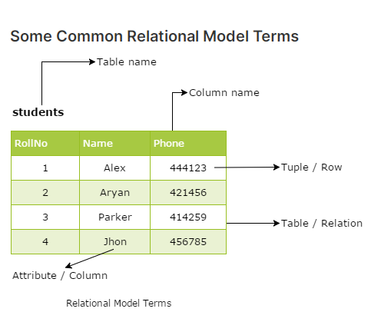
A database schema is a skeletal structure that represents the logical view of the complete database. It describes how the data is organized and how the relations among them are associated and formulates all the constraints that are to be applied to the data.
Relation: A relation is a table with columns and rows.
Attribute: An attribute is a named column of a relation.
Domain: A domain is the set of allowable values for one or more attributes.
Tuple: A tuple is a row of a relation.

Slide 4

A data sublanguage mainly has two parts:
Data Definition Language (DDL) and
Data Manipulation Language (DML).
Data Definition Language (DDL) statements are used to classify the database structure or schema. It is a type of language that allows the DBA or user to depict and name those entities, attributes, and relationships that are required for the application along with any associated integrity and security constraints. Here are the lists of tasks that come under DDL.
CREATE - used to create objects in the database
ALTER - used to alters the structure of the database
DROP - used to delete objects from the database
TRUNCATE - used to remove all records from a table, including all spaces allocated for the records are removed
COMMENT - used to add comments to the data dictionary
RENAME - used to rename an object

Slide 5
A language that offers a set of operations to support the fundamental data manipulation operations on the data held in the database. Data Manipulation Language (DML) statements are used to manage data within schema objects. Here are the lists of tasks that come under DML:
SELECT - It retrieves data from a database
INSERT - It inserts data into a table
UPDATE - It updates existing data within a table
DELETE - It deletes all records from a table, the space for the records remain
LOCK TABLE - It controls concurrency

Slide 6
Data Control Language (DCL) :
There are two other forms of database sub-languages. The Data Control Language (DCL) is used to control privilege in Databases. To perform any operation in the database, such as for creating tables, sequences, or views, we need privileges.
Privileges are of two types:
System - creating a session, table, etc. are all types of system privilege.
Object - any command or query to work on tables comes under object
privilege.
DCL is used to define two commands. These are:
Grant - It gives user access privileges to a database.
Revoke - It takes back permissions from the user.

Slide 7
Transaction Control statements are used to run the changes made by DML statements. It allows statements to be grouped into logical transactions.
COMMIT - It saves the work done
SAVEPOINT - It identifies a point in a transaction to which you can later roll back
ROLLBACK - It restores the database to original since the last COMMIT

Slide 8
What is SQL?
SQL (Structured Query Language) is a computer-based structured, formatted database language designed for managing data in relational database managing systems (RDBMS).
SQL is Structured Query Language, which was initially developed by IBM.
SQL is pronounced as "sequel".
SQL is a computer language for storing, manipulating, and retrieving data in a relational database.
SQL is the standard language for Relation Database System

Slide 9
SQL Syntax Rule :
SQL statements always start with the keywords.
SQL statement ends with a semicolon.
SQL is not case sensitive, means the update is the same as UPDATE
SQL Create Database :
Syntax:
CREATE DATABASE database_name;
Example:
CREATE DATABASE my_database;

Slide 10
Data Types :
Numeric Data Type | String Data Type
INT | CHAR(size)
TINYINT | VARCHAR(size)
SMALLINT | TINYTEXT(size)
MEDIUMINT | TEXT(size)
BIGINT | MEDIUMTEXT(size)
FLOAT(m,d) | LONGTEXT(size)
DOUBLE(m,d) | BINARY(size)
DECIMAL(m,d) | VARBINARY(size)

Slide 11
SQL Use Database
USE DatabaseName;
SQL Create Table :
Syntax:
CREATE TABLE table_name
( column_name1 datatype(size),
column_name2 datatype(size),
column_name3 datatype(size));

Slide 12
Example:
CREATE TABLE tbl_employee ( employee_id INT, last_name VARCHAR(100), first_name VARCHAR(100), address VARCHAR(255) );
Create Table Using Another Table
A copy of an existing table can also be created using CREATE TABLE.
The new table gets the same column definitions.
All columns or specific columns can be selected.
If you create a new table using an existing table, the new table will be filled with the existing values from the old table.

Slide 13
Syntax:
CREATE TABLE new_table_name AS SELECT column1, column2,... FROM existing_table_name WHERE ....;
Example
CREATE TABLE TestTable AS SELECT customername, contactname FROM customers;

Slide 14
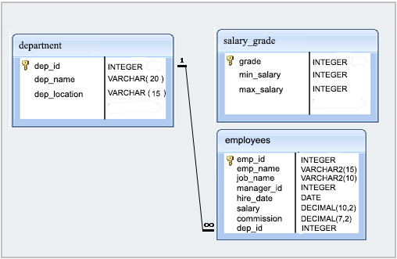
Structure of employee Database:

Slide 15
SQL ALTER TABLE Statement
The ALTER TABLE statement is used to add, delete, or modify columns in an existing table.
ALTER TABLE - ADD Column
Syntax:
ALTER TABLE table_name ADD column_name datatype;
The following SQL adds an "Email" column to the “employees" table:
Example
ALTER TABLE employees ADD Email varchar(255);

Slide 16
ALTER TABLE - DROP COLUMN
Syntax:
ALTER TABLE table_name DROP column_name;
Example:
ALTER TABLE employees DROP Email;
Renaming (Altering) a Table:
ALTER TABLE testalter_tbl RENAME TO alter_tbl;

Slide 17
ALTER TABLE - ALTER/MODIFY COLUMN
To change the data type of a column in a table, use the following
Example:
ALTER TABLE Persons ADD DateOfBirth date;
Change Data Type Example
ALTER TABLE Persons modify DateOfBirth year;
ALTER TABLE testalter_tbl DROP i;
ALTER TABLE testalter_tbl ADD i INT FIRST;
ALTER TABLE testalter_tbl DROP i;
ALTER TABLE testalter_tbl ADD i INT AFTER c;

Slide 18
The SQL DROP TABLE statement is used to remove a table definition and all the data, indexes, triggers, constraints and permission specifications for that table.
Syntax:
DROP TABLE table_name;
Example:
DROP table tbl_employee;

Slide 19
TRUNCATE TABLE
The TRUNCATE TABLE command deletes the data inside a table, but not the table itself.
The following SQL truncates the table "Categories":
Example
TRUNCATE TABLE Categories;

Slide 20
Difference between Delete and Truncate :
DELETE :
DELETE is a DML(Data Manipulation Language) command
It is used to delete the specify row(tuple) from the table
The DELETE command can contain a WHERE clause.
2. TRUNCATE :
TRUNCATE is a DDL(Data Definition Language) command
It is used to delete all the rows or tuples from a table.
Unlike the DELETE command, TRUNCATE command does not contain a WHERE clause.

Slide 21
NOT NULL Constraint − Ensures that a column cannot have NULL value.
DEFAULT Constraint − Provides a default value for a column when none is specified.
UNIQUE Constraint − Ensures that all values in a column are different.
PRIMARY Key − Uniquely identifies each row/record in a database table.
FOREIGN Key − Uniquely identifies a row/record in any of the given database table.
CHECK Constraint − The CHECK constraint ensures that all the values in a column satisfies certain conditions.

